Slide 1
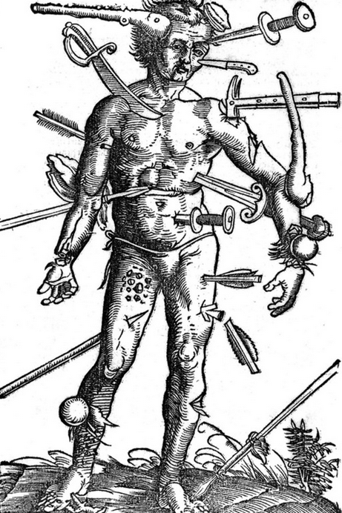
Wounds training 29.9.2021 Sinisa Simonovic- Medical Writer | Scientific Consultant
GCP-Service International

Slide 2
Purpose and Contents
Basic information on different acute and chronic wounds,
concepts and terminology in wound healing and management,
common wound assessment tools used in clinical trials
-Wounds
Pressure ulcers
Diabetic foot ulcers
Venous leg ulcers
Surgical wounds
Burns
-Wound healing
Healing inhibition in chronic wounds
Terminology in wound healing and management
-Wound assessment- TIME and TWA frameworks
-Assessment tools in clinical trials
Accompanying reading material
Test
GCP-Service International

Slide 3
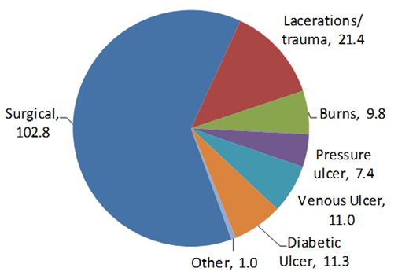
Introduction
Acute
Wounds
Chronic (pressure ulcers, diabetic foot ulcers, venous ulcers and
arterial ulcers)
Chronic wounds
much more common in older people
dramatically reduce patients’ quality of life
high costs to the health care system
great variation in care
Worldwide wound incidence (millions)
Acute
Wounds
Chronic
GCP-Service International

Slide 4
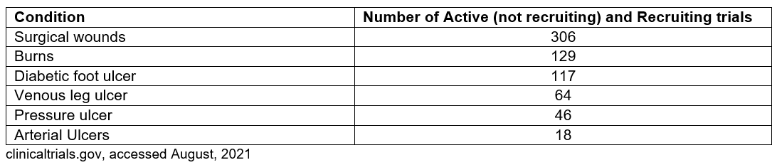
Introduction
Conducting clinical trials in wound care is difficult
availability of patients in a given time period (trial length, budget)
doing blinded studies is difficult
Acute wound patients
prevalence of acute wounds uncertain within a specific time frame; young pateints- exclusion criteria
Chronic wound patients
elderly patients, concomitant diseases, limitations in mobility
GCP-Service International

Slide 5
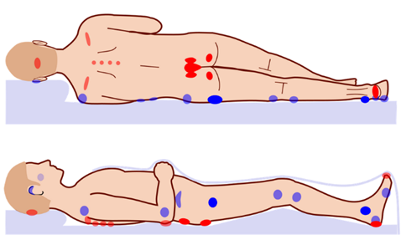
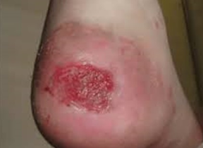
Pressure ulcers
skin and underlying tissue is injured because of long term pressure or friction, ulceration usually develops from ischemia
bony area of the body- sacrum, coccyx, heels, hips, elbows
common in people with paralysis and during acute care hospitalizations
risk factors- malnutrition, diabetes, loss of sensation, and hypotension
GCP-Service International

Slide 6
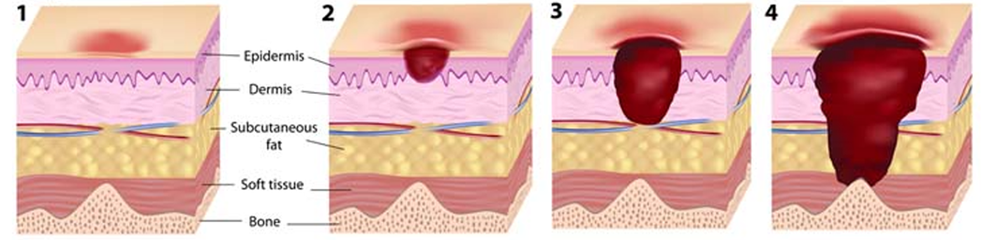
Pressure ulcers
Classification - depending on their depth and affected tissues
Stage I – discolored and painful skin
Stage II - open wound or blister
Stage III - reaches to deepest layer of the skin
Stage IV – exposure of bone/muscle, necrosis, smell
Prevention and treatment
Redistribution of pressure to other body areas, regularly turning the patient;
cleaning, antiseptics, and wound dressings
GCP-Service International

Slide 7
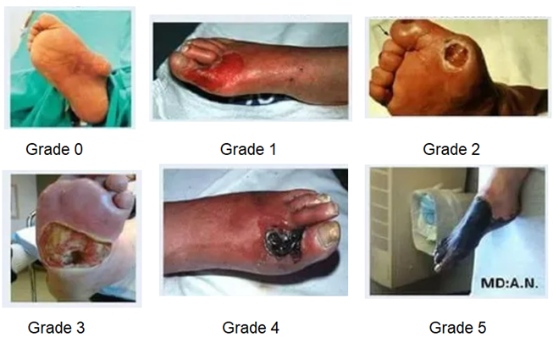
Diabetic foot ulcers
Complication of diabetes mellitus, and the main component of the diabetic foot
- 15% of people with diabetes affected, main cause of lower-leg amputations
- common under big toes and the balls of feet
- weeks or months to heal, longer in case of high blood sugar and pressure to ulcer
- neuropathy- unnoticed injuries- infections and hindered healing
Wagner grading system
0- no ulcer present
1- ulcer involving all skin layers
2- involving ligaments and muscle
3- abscess or infection of muscle,
tendon, bone)
4- limited gangrene
5- extensive gangrene
GCP-Service International

Slide 8
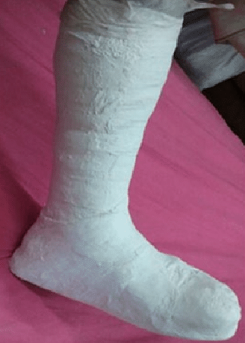
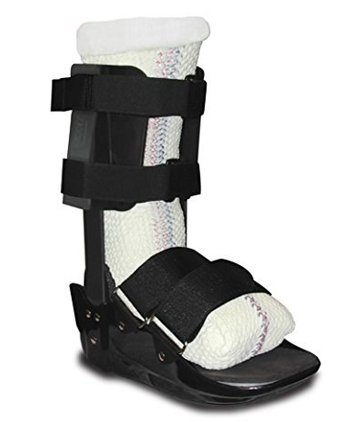
Diabetic foot ulcers
Prevention
foot care and hygiene, injury avoidance, special diabetic footwear, patient education, frequent doctor examinations
Treatment
-management of diabetes and improvement of glycemic control
-wound care (cleansing, debridement, dressings and bandaging), antibiotics
-staying off the feet to prevent pain and pressure
-off-loading (redistribution of weight-bearing load to larger foot area)
total contact casting (TCC)
-surgery, hyperbaric oxygen therapy, negative pressure therapy, ozone, phototherapy
GCP-Service International

Slide 9
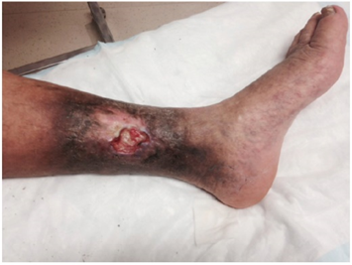
Venous leg ulcers
Breaks in the skin unable to heal for at least 6 weeks (chronic VLUs)
in gaiter region of the lower leg
shallow, irregularly shaped, heavily exudative
single ulcer lasts 6 to 9 months, high recurrence rate
severe distress and negative effect on the quality of life,
pain, patents’ mobility and the ability to work limited,
frequent hospital visits necessary
Causes
-abnormalities of vein walls
valves fail to close- swelling and stretching of outside veins- retrograde blood flow-
venous hypertension- venous insufficiency- ulcer
-dysfunction of the calf muscle pump
promotes blood return from lower extremities against gravitational force,
depends on the full range of motion of ankle joint
GCP-Service International

Slide 10
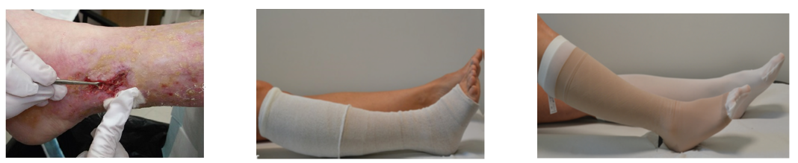
Venous leg ulcers
Risk factors
Age, family history, more common in obese and sedentary individuals, smoking
Treatment
first-line treatment is compression therapy, combats venous insufficiency and
assists venous return; elastic bandages with multiple layers and compression
stockings
cleansing
topical agents (hydrogels, ointments and creams)
dressings (absorbent, foam, honey, iodine, silver)
unclear which cleansing solutions, topical agents and dressings are ideal
GCP-Service International

Slide 11
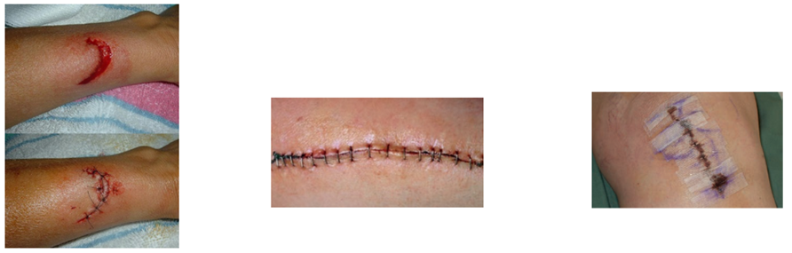
Surgical wounds
Incision in the skin normally made by a scalpel during surgery, and usually closed with sutures
made in optimum conditions in a sterile environment
acute wound healing pathway, healing is not usually compromised
wound reepithelizes within 1-2 days
main aspect in care is preventing infection
surgical site infection (SSI) rates- historically 70%- 90%, with 30%-50% death
rate; today 10%
GCP-Service International

Slide 12
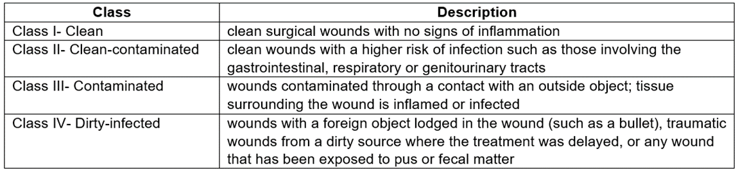
Surgical wounds
Classification based on cleanliness and risk of infection
Risk factors for SSI- diabetes, weakened immune system, smoking (immuno-compromised, immuno-suppressed and nutritionally deprived patients)
wound dehiscence- reopening of the surgical incision
antibiotics prior to and after surgery
GCP-Service International

Slide 13
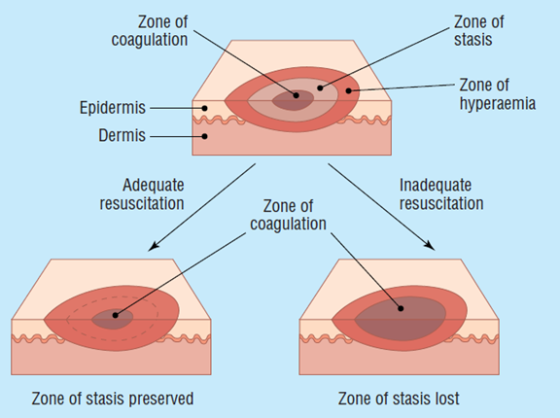
Burns
Tissue injuries resulting from heat (86%), radiation, chemical or electrical contact
local or systemic response depending on the extent of burn
local response: zone of coagulation
zone of stasis
zone of hyperemia
systemic response:
- 30% of total body surface
- locally cytokines have systemic effect
GCP-Service International

Slide 14
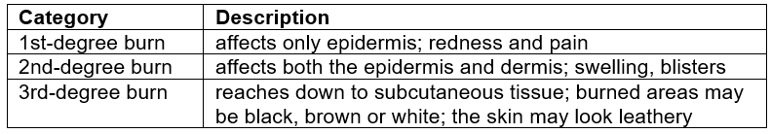
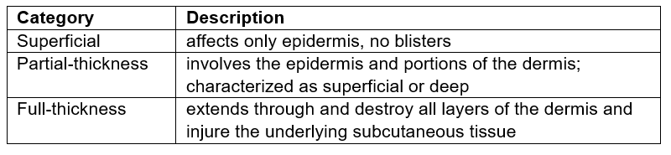
Burns
Classification
Revised classification
first-degree sunburn second-degree burn third-degree burn

Slide 15
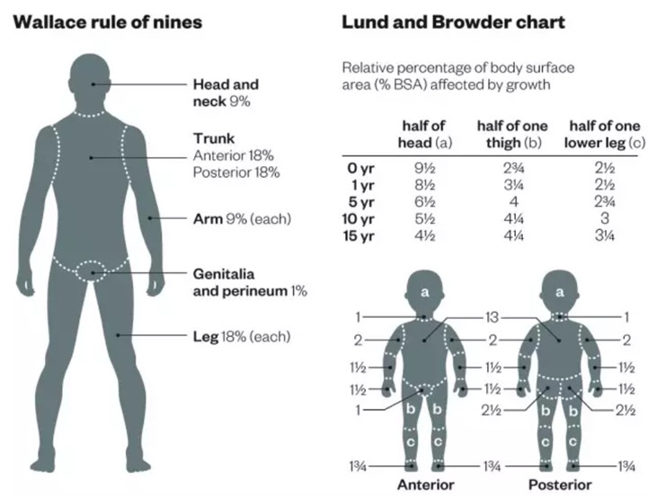
Burns
Burn surface area (BSA) as percentage of total body surface area
Wallace rule of nines and Lund and Browder chart (children)
quick estimate of how much body surface area is burned
location of a burn relevant in directing
treatment (burn centers)
electrical and chemical burns usually
deep

Slide 16
Burns
Complications
bacterial infection, fluid loss, hypothermia (especially in children and the elderly), scar tissue; third-degree burns carry the risk of blood loss and shock
Treatment
minor burns - at home by cooling and applying moisturizing lotions
serious burns - medications, wound dressings, surgery, fluids to prevent dehydration, antibiotics in case of infection, skin grafts

Slide 17
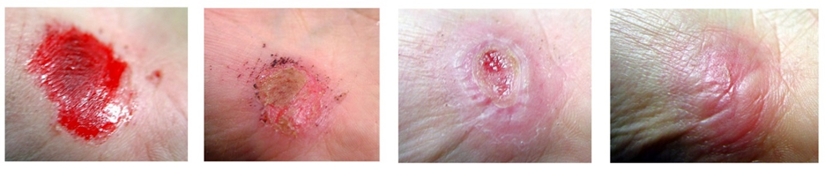
Wound healing
complex and dynamic process regulated by cellular, humoral and molecular mechanisms
interruptions and complications result in chronic wounds
factors negatively affecting wound healing: ischemia, infection, edema, presence of foreign bodies, metabolic or nutritional deficiencies, diabetes
Four phases: hemostasis, inflammation, proliferation, maturation
Healing of a hand
abrasion

Slide 18
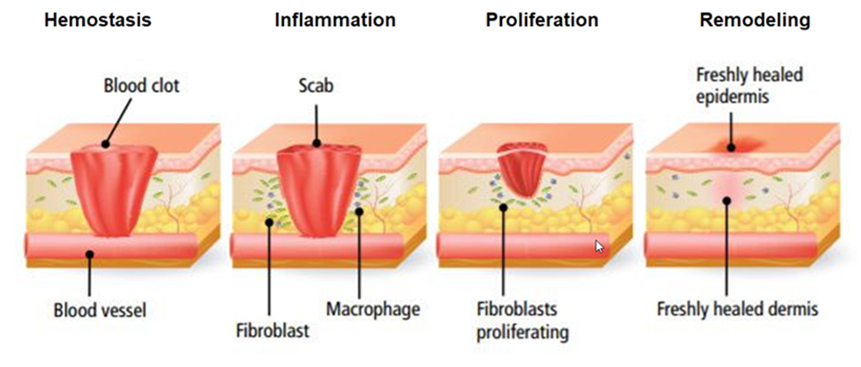
Wound healing
Hemostasis - platelets form a blood clot, release of cytokines and growth factors that initiate inflammatory response
Inflammation - blood vessels dilatate, immune cells arrive, neutrophils release proteolytic enzymes, monocytes transform into macrophages (phagocytosis, secretion of TNF and interleukins)
Proliferation – proliferation of fibroblasts, deposition of collagen, angiogenesis, epithelialization, formation of granulation tissue, myofibroblasts contract wound edges
Maturation – remodeling of ECM, deposition of mature collagen in an organized network, apoptosis, wound closure

Slide 19
Healing inhibition in chronic wounds
Defective remodeling of the ECM, a failure to reepithelialize, prolonged inflammation, hyper-proliferation at wound margins
chronic wounds are arrested in inflammatory or proliferative phase
neutrophiles remain longer and damage healthy tissue
altered gene expression of various key cells
high levels of proteolytic enzymes, inflammatory cytokines (TNFα and IL-1), matrix molecules; low levels of growth factors
Biofilm is present in over 90% of chronic wounds
- complex layer of microorganisms embedded in the wound
- protected from immune response and antibiotics
- release of cytotoxins

Slide 20
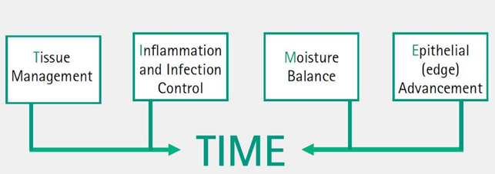
Wound assessment- TIME framework
Holistic wound assessment
TIMERS (R- repair/regeneration,
S- social factors)
Triangle of Wound Assessment (TWA) - three zones (wound bed, wound edge, and periwound skin)
Wound bed preparation- management of a wound in order to accelerate healing and/or facilitate other therapeutic measures
Debridement- removal of dead and abnormal tissue, foreign material, excessive exudate and bacteria from the wound
contamination – colonization - critical colonization - infection
Moisture balance is essential for wound healing
Healthy wound edges are advancing and contracting the wound

Slide 21
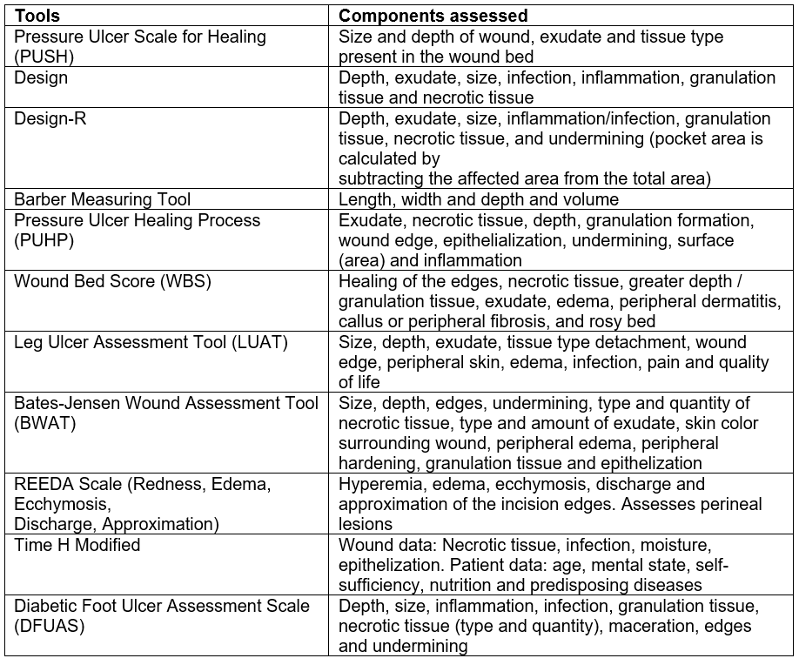
Wound assessment in clinical trials
Wound size, tissue type,
exudate, signs of infection
or inflammation,
wound pain

Slide 22
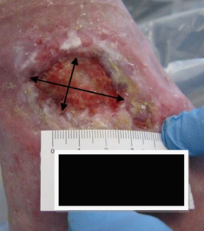
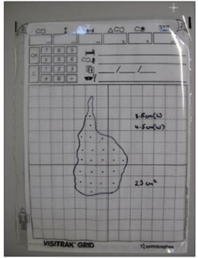
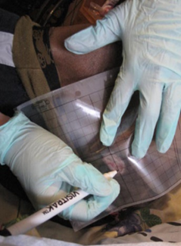
Wound size measurement
changes in wound size are a key indicator of wound status,
healing, response to treatment
should not be used in isolation
Ruler
longest length x greatest width = estimated surface area
Tracing method
marker is used to draw around the wound outline on a sheet;
sheet is dated, labelled, stored in the patient’s record
higher accuracy; subjectivity in including partial squares
Photography
provides more information about the wound, photos must have a to ruler provide an objective view of size and are taken at the same distance from the wound each time, with patient in same position

Slide 23
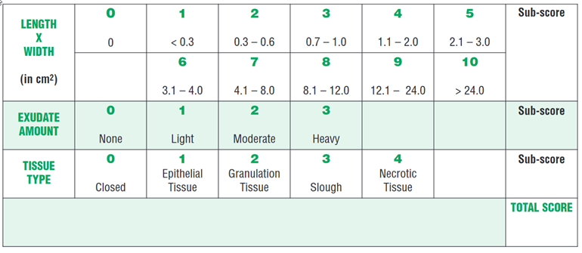
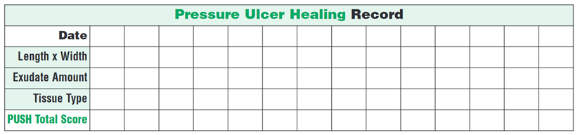
PUSH
Pressure Ulcer Scale for Healing (PUSH)
quick and easy tool that evaluates pressure ulcers and other types of wounds
measures three parameters
-subscores are added to arrive at a
total score
-total scores range from 0 to 17,
smaller values- closer to healing
-neglect of wound depth

Slide 24
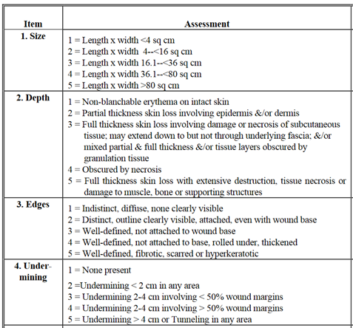
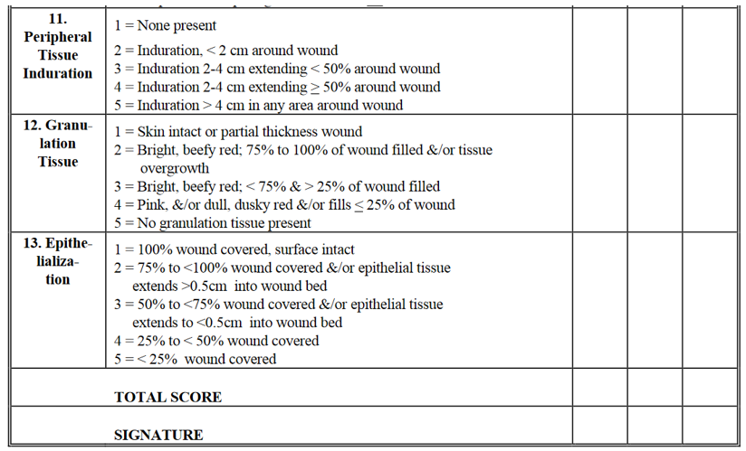
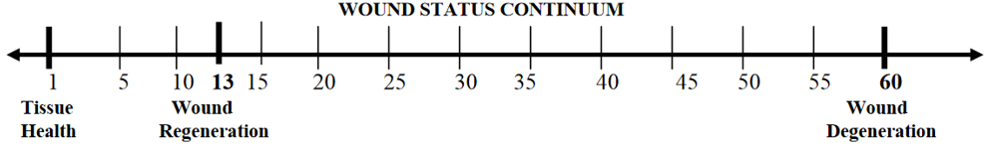
BWAT
Bates-Jensen wound assessment tool (BWAT)
applicable to a wide variety of wounds
assesses 13 items
1- healthiest, 5- unhealthiest attribute
- scores are added up to produce a total score
- smaller value- wound closer to healing
- total scores can be plotted on a Likert scale
- used for development of other tools

Slide 25
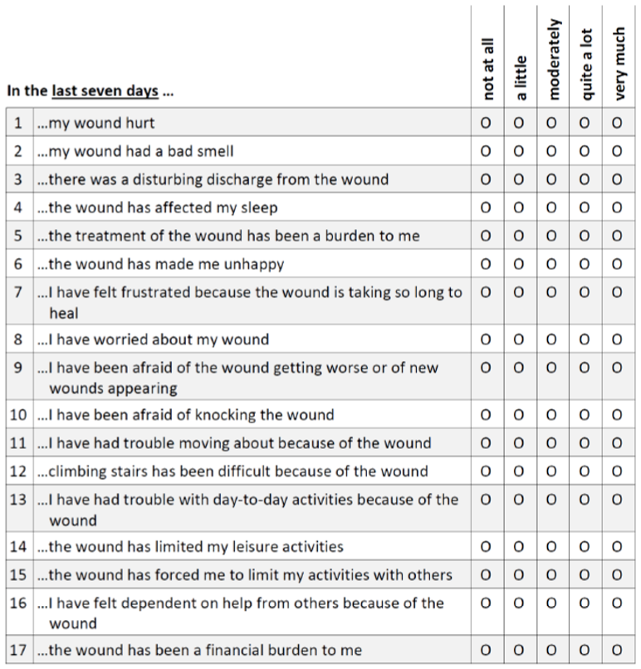
Wound quality of life (QoL) questionnaire
17 items assessing impairments within past 7 days
- 0=’not at all’ to 4=’very much’
- global score is computed by averaging all items
- minimal important difference (MID) in overall score is 0.5
- subscales (‘Body’, ‘Psyche’, ‘Everyday life’)

Slide 26
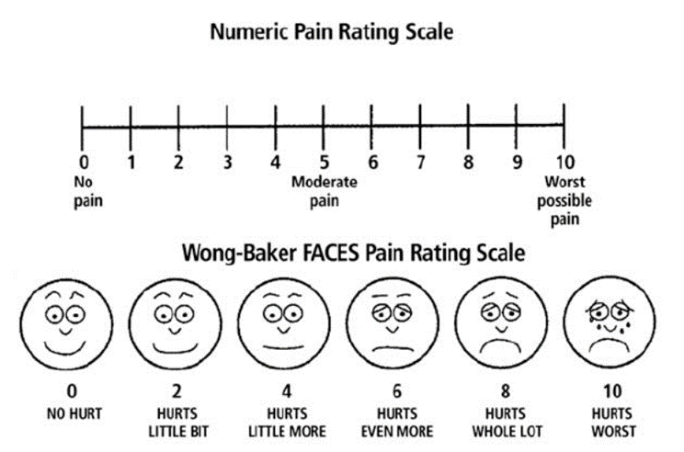
Visual analogue scale (VAS) for wound pain
- psychometric response scale
- patients indicate their level of agreement to a statement by indicating a position along a continuous line
- Wong-Baker Faces-Rating Scale (FRS) to assess pain in pediatric or geriatric patients
- additional specialized pain assessment tools for chronic pain

Slide 27
Sinisa Simonovic
Medical Writer | Scientific Consultant
Anne-Conway-Straße
28359 Bremen, Germany
Tel : +49 (0)421 89 67 66 78
Email : ssimonovic@gcp-service.com
Web :www.gcp-service.com
GCP-Service International

